Slide 1
EXCHANGE SORTS

Slide 2
In Exchange sorts, elements that are out of
order are exchanged until the entire list is sorted.
The most common Exchange sorts are
Bubble sort
Quick sort

Slide 3
QUICK SORT
Each iteration of the Quick Sort selects an element, known as pivot, and divides the list into 3 groups
the pivot element that is placed in its
ultimately correct in the list.
ii) A partition of elements greater than pivot’s key
iii) A partition of elements equal to
pivot’s key.

Slide 4
Algorithm Quicksort(A, N)
Intialize TOP := NULL;
// Push bounadary values of A onto stacks when A has 2 or more
elements.//
If N > 1
{
TOP := TOP + 1
LOWER[1] := 1 ;
UPPER[1] := N;
}
3) Repeat Steps 4 to 7 while TOP != NULL
{
4) // Pop sublist from stacks//
Set BEG : = LOWER[TOP]
END := UPPER[TOP]
TOP := TOP - 1
5) Call Quick(A,N, BEG,END, LOC)

Slide 5
6) // Push left sublist onto stacks when it has 2 or more elements //
If BEG < LOC – 1
{
TOP := TOP + 1
LOWER[TOP] := BEG;
UPPER[TOP] := LOC – 1;
}
7) // Push right sublist onto stacks when it has 2 or more elements //
If LOC + 1 < END
{
TOP := TOP + 1
LOWER[TOP] := LOC + 1
UPPER[TOP] := END
}
} // END OF STEP 3 LOOP
8) EXIT

Slide 6
QUICK(A,N,BEG,END,LOC)
1) Intialize
Set LEFT := BEG
RIGHT := END
LOC := BEG
2) // Scan from right to left //
a) Repeat while A[LOC] <= A[RIGHT] .AND. LOC != RIGHT
{
RIGHT := RIGHT – 1
} // END OF LOOP
b) If LOC = RIGHT then : Return
c) If A[LOC] > A[RIGHT]
{
// interchange A[LOC] and A[RIGHT]
TEMP := A[LOC]
A[LOC] := A[RIGHT]
A[RIGHT] := TEMP
// SET LOC := RIGHT
// GO TO step 3
}

Slide 7
3) // scan from left to right //
Repeat while A[LEFT] <= A[LOC] .AND. LOC != LEFT
{
LEFT <=LOC
LEFT := LEFT + 1
} // END OF LOOP
b) If LOC = LEFT then Return
c) If A[LEFT] > A[LOC] then
{
// Interchange A[LEFT] and A[LOC]
TEMP := A[LOC]
A[LOC] := A[LEFT]
A[LEFT] := TEMP
// SET LOC := LEFT
GO TO STEP 2
} // End of if structure

Slide 8
The reduction step of the quick sort algorithm finds the
final position of one of the numbers .In the given
example, we use the first number 44.
44 , 33, 11, 55, 77, 90,40, 60, 99, 22, 88, 66
Begin with the last number 66 scan list from right to
left comparing with 44 & stop when a number less than
44 comes. Interchange 44 & 22.
22 , 33, 11, 55, 77, 90,40, 60, 99, 44 , 88, 66
Begin with 22,scan the list in opposite direction from
left to right,comparing with 44 & stop when a number
greater than 44 comes. Interchange 44 & 55.
22 , 33, 11, 44, 77, 90,40, 60, 99, 55 , 88, 66

Slide 9
Observe that the numbers 22, 33 and 11 to the
Left of 44 are each less than 44. Beginning this time with
55, now scan the list in the original direction , from right
to left,until meeting the first number less than 44. it is 40.
Interchange 44 and 40 to obtain the list.
22 , 33, 11, 40, 77, 90,44, 60, 99, 55 , 88, 66
Again the numbers to the right of 44 are each greater
than 44 . Beginning with 40, scan the list from left to right
The first number greater than 44 is 77. Interchange 44
and 77 to obtain the list.
22 , 33, 11, 40, 44, 90,77, 60, 99, 55 , 88, 66

Slide 10
Beginning with 77, scan the list from right to left
seeking a number less than 44. we do not meet such a
number before meeting 44. All the numbers are scanned
and compared with 44. Now the numbers all less than
44 form one sublist and all numbers greater than 44
form another sublist. 44 is placed in the middle and is
the correct Position.
After 1st pass,the list is divided into two sublists,which
are further sorted accordingly.
The upper & lower bounds of lists are pushed on
stacks.
Lower :1 upper:12
Lower :empty Upper:empty.
Lower:1,6 Upper:4,12 and so on.
The algorithm ends when the stacks do not contain
any sublist to be processed by the reduction step.

Slide 11
A[6], A[7], A[8], A[9], A[10], A[11], A[12]
90, 77, 60, 99, 55, 88, 66
66, 77, 60, 99, 55, 88, 90
66, 77, 60, 90, 55, 88, 99
66, 77, 60, 88, 55, 90, 99

Slide 12
Bubble Sort
Suppose the list of numbers A[1], A[2], ..A[N]
is in memory. The Bubble sort algorithm works as
follows.
Compare A[1] and A[2] and arrange them in
the desired order, then compare A[2] and A[3]
and arrange them so that A[2] < A[3]. Then
compare A[3] and A[4] and arrange them so that
A[3] < A[4]. Continue until we compare A[N – 1]
with A[N] and arrange them so that
A[N – 1] < A[N].

Slide 13
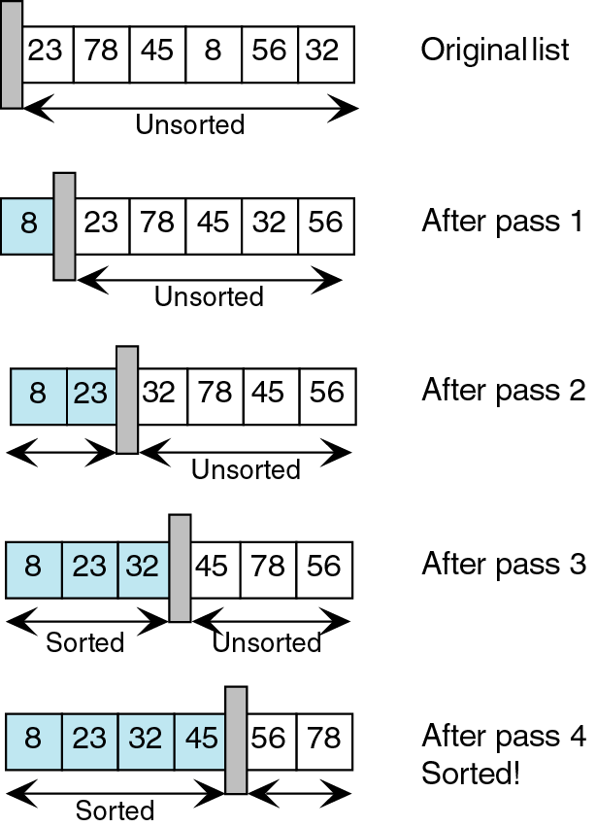

Slide 14
Algorithm Bubblesort(DATA, N)
// DATA is an array with N elements. This
algorithm sorts the elements in DATA. //
Repeat steps 2 and 3 for k = 1 to N – 1
// Initialises the pass pointer PTR
Set PTR : = 1
3) Repeat while PTR <= N – K // Execute pass
If DATA[PTR] > DATA[PTR + 1]
Interchange DATA[PTR] and DATA[PTR + 1]
b) Set PTR := PTR + 1
} // END OF INNER LOOP
} // END OF STEP 1 OUTER LOOP
4) EXIT.

